Slide 1
Introduction to Java Programming Lecture 10: Assignment – RSA Public-Key Cryptography

Slide 2
What is RSA Public Key Cryptography?
In public-key cryptography, each participant has a public key and a secret key. In RSA, keys are pairs of integers
“Alice” has P_{A}, S_{A}; “Bob” has P_{B}, S_{B}
Participants create key pairs, keep secret their secret key, publish their public key
M = S_{A} {P_{A} (M)}} and M = P_{A} {S_{A} (M)}} so matched pair and inverse function, but knowing P_{A} will not give you S_{A}

Slide 3
Sending Alice a Message
Bob gets Alice’s public key P_{A} from Alice or a public directory
Bob computes the ciphertext C = P_{A} (M) encrypting the message M and sends C to Alice
When Alice receives the ciphertext C, she applies her secret key S_{A} to retrieve the message: S_{A} (C)= S_{A} {P_{A} (M)}} = M
If Alice wants to send an encrypted message to Bob, she encrypts her message using Bob’s public key P_{B}

Slide 4
Alice Signs a Message
Alice computes her digital signature σ (sigma) for a message M’ using her secret key S_{A} and the equation σ = S_{A} (M’)
Alice sends the pair (M’, σ) to Bob
Bob uses Alice’s public key P_{A} to verify the equation M’ = P_{A} (σ) (assume that M’ contains Alice’s name so that Bob knows which public key to use)
If the equation holds, Bob can conclude that the message M’ was signed by Alice
If the equation does not hold, Bob concludes either that the message M’ or the signature σ were corrupted in transmission or that the pair (M’, σ) is a forgery

Slide 5
Mathematical Definitions
An integer a > 1 whose only divisors are 1 and a is a prime number
The first 10 primes are 2, 3, 5, 7, 11, 13, 17, 19, 23 and 29
If d is a divisor of a and d is also a divisor of b, then d is a common divisor of a and b
Divisors of 30 are 1, 2, 3, 5, 6, 10, 15 and 30; divisors of 24 are 1, 2, 3, 4, 6, 8, 12, and 24. Common divisors are 1, 2, 3, and 6
Greatest common divisor of a and b [ gcd(a,b) ] is largest of common divisors of a and b, so gcd(24, 30) is 6. For a, b > 0, 1 ≤ gcd(a,b) ≤ min(a, b)

Slide 6
Mathematical Definitions 2
Two integers a and b are relatively prime if their only common divisor is 1, i.e. gcd(a, b) = 1.
E.g. 8 and 15 are relatively prime, divisors of 8 are 1, 2, 4, 8, divisors of 15 are 1, 3, 5, 15

Slide 7
Mathematical Definitions 3
For a positive integer n, Euler’s phi function φ(n) is the number of positive integers less than n and relatively prime to n
Examples:
φ(3) = 2 1,2
φ(4) = 2 1,2,3 (2 is not relatively prime to 4)
φ(5) = 4 1,2,3,4
φ(10) = 7 1,2,3,4,5,6,7,8,9 (2 and 5 not relatively prime to 10)
For any prime number p,
φ(p) = p-1
For any integer n that is the product of two distinct primes p and q,
φ(n) = φ(p)φ(q) = (p-1)(q-1)

Slide 8
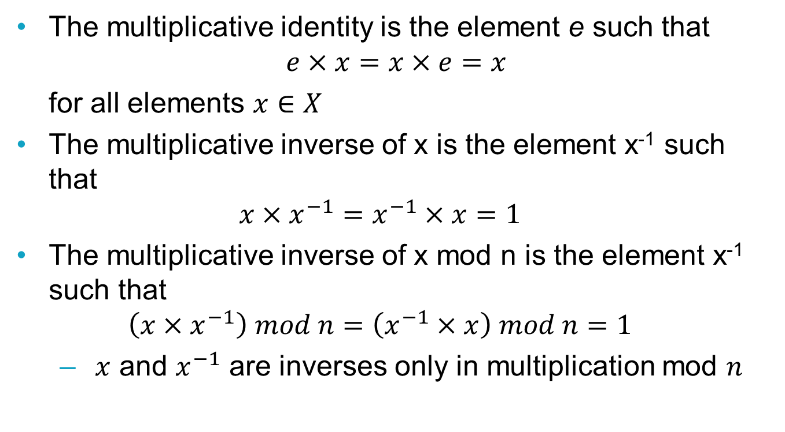
Mathematical Definitions 4
The multiplicative identity is the element e such that
$$e×x=x×e=x$$
for all elements $x∈X$
The multiplicative inverse of x is the element x⁻¹ such that
$$x×x^{−1}=x^{−1}×x=1$$
The multiplicative inverse of x mod n is the element x⁻¹ such that
$$\left(x×x^{−1}\right) mod n=\left(x^{−1}×x\right) mod n=1$$
$x$ and $x^{−1}$ are inverses only in multiplication mod $n$

Slide 9
Creating Key Pairs
Select at random two large primes, p and q such that p ≠ q. Primes should be 1024 to 2048 bits each
Compute n = pq
Select a small odd integer e that is relatively prime to Φ(n) (this is phi and is Euler’s tortion function where Φ(n) = (p -1)(q-1) ), i.e. gcd(e, Φ(n) ) = 1
Compute d as the multiplicative inverse of e, modulo Φ(n)
Publish the pair P = (e, n) as the public key
Keep secret the pair S = (d, n) as the secret key

Slide 10
Encrypting and Decrypting
To encrypt a message M:
P(M) = Me mod n
To decrypt a ciphertext C
S(C) = C^{d} mod n

Slide 11
Pieces of the Puzzle
How to manipulate really big numbers?
How to find big primes?
How to compute gcd?
How to compute the modular inverse?
How to convert text into numeric values?
How to do the modular exponentiation?

Slide 12
Really Big Numbers
BigInteger is a Java class which allows representation and calculation on integers of arbitrary precision
Provides analogous operations to standard int operations and Integer methods, e.g. addition, subtraction, multiplication and division
Moreover BigInteger also has methods for modular arithmetic, greatest common divisor, prime generation and prime testing

Slide 13
Making Primes 1
BigInteger probablePrime(int b, Random rng)
Returns random positive BigInteger of bit length b that is “probably” prime
probability that BigInteger is not prime < 2⁻¹⁰⁰
Random is Java’s class for random number generation
The following statement
Random rng = new Random();
creates a new random number generator named rng

Slide 14
Making Primes 2
/* create a random number generator */
Random rng = new Random();
/* declare p and q as type BigInteger */
BigInteger p, q;
/* assign 32-bit length values to p and q as required */
p = BigInteger.probablePrime(32, rng);
q = BigInteger.probablePrime(32, rng);

Slide 15
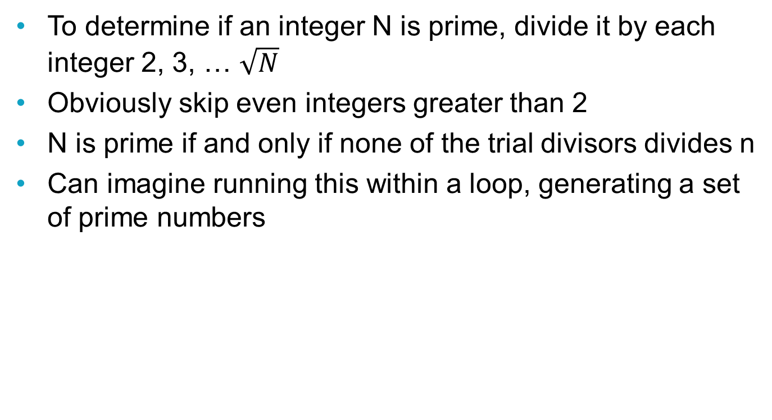
Finding Primes by Trial Division
To determine if an integer N is prime, divide it by each integer 2, 3, … $\sqrt{N}$
Obviously skip even integers greater than 2
N is prime if and only if none of the trial divisors divides n
Can imagine running this within a loop, generating a set of prime numbers

Slide 16
Making Primes using a Sieve
The Sieve of Eratosthenes:
Create a list of consecutive integers from 2 through n: (2, 3, 4, ..., n).
Let p equal 2, the first prime number.
Starting from p, enumerate its multiples by counting to n in increments of p, and mark them in the list (these will be 2p, 3p, 4p, etc.; do not mark p).
Find the first number > p in the list that is not marked. If no such number, stop, else p = this new number (which is the next prime), and repeat from step 3.
When the algorithm terminates, all the numbers in the list that are not marked are prime. Various tweaks possible

Slide 17
Finding the GCD
If p and q are BigIntegers, then have
BigInteger w = p.add(q);
BigInteger x = p.subtract(q);
BigInteger y = p.multiply(q);
BigInteger z = p.divide(q);
But also have the gcd method
BigInteger gcdvalue = p.gcd(q)

Slide 18
Recursion
Recursion is a programming technique where a method calls itself to solve a problem
A recursive method calls itself
When a recursive method calls itself, it does so to solve a (progressively) smaller problem
There is a version of the problem that is simple enough that the method can solve it and return without calling itself
Recursive calls create overheads in terms of control transfer and stack storage.
Iteration may be more efficient but recursion can make a problem conceptually easier

Slide 19
Finding the GCD by Euclid’s Algorithm
Created by Euclid (circa 300 BC)
Expressible as a recursive program
EUCLID(a, b) /* non-negative a and b)
If b==0
return a
Else return EUCLID(b, a mod b)
EUCLID(30, 21) = EUCLID(21, 9)
= EUCLID(9, 3)
= EUCLID(3,0)
= 3

Slide 20
Relative primes
For an integer x and want an odd integer z such that
1 < z < x, and
z is relatively prime to x, THEN:
randomly generate prime values for z until gcd(x,z) = 1
if x is a product of distinct primes, there is a value of z satisfying this equality
For a BigInteger x, declare a BigInteger z, and assign a prime value to z using probablePrime method
specify an input bit length < of x gives a value z < x
(x.gcd(z)).equals(BigInteger.ONE)
/* returns true if gcd(x,z) = 1 and false else */
While the above expression evaluates to false, assign a new random to z

Slide 21
modInverse
If have created BigInteger variables x and y, and have assigned values to them, and want to find a BigInteger z such that
(x*z)%y =(z*x)%y = 1
that is, want to find the inverse of x mod y and assign its value to z
Use the modInverse method as follows:
BigInteger z = x.modInverse(y);

Slide 22
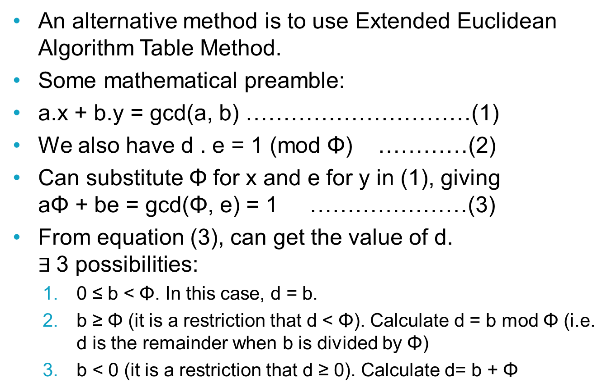
modInverse by Extended Euclid
An alternative method is to use Extended Euclidean Algorithm Table Method.
Some mathematical preamble:
a.x + b.y = gcd(a, b) …………………………(1)
We also have d . e = 1 (mod Φ) …………(2)
Can substitute Φ for x and e for y in (1), giving aΦ + be = gcd(Φ, e) = 1 …………………(3)
From equation (3), can get the value of d. $∃$3 possibilities:
0 ≤ b < Φ. In this case, d = b.
b ≥ Φ (it is a restriction that d < Φ). Calculate d = b mod Φ (i.e. d is the remainder when b is divided by Φ)
b < 0 (it is a restriction that d ≥ 0). Calculate d= b + Φ

Slide 23
modInverse by Extended Euclid
Extended-Euclid(a, b)
If b == 0
return (a, 1, 0)
Else (d’, x’, y’) = Extended-Euclid(b, a mod b)
(d, x, y) = (d’, y’, x’ – floor( a / b) y’)
return (d, x, y)

Slide 24
Converting Text to Numbers
All of the operations require numbers but messages are usually text.
Convert individual characters to their ASCII codes or if you are feeling brave to Unicode
Typically encryption and decryption will be on multiple letters at a time.
Concatenate the converted values of characters, do not add or multiply (or other arithmetic operation) them together (or they become gibberish)

Slide 25
Modular Exponentiation
Encryption and decryption can be done using the modPow method for BigIntegers
If x is a BigInteger,
x.modPow(BigInteger exponent, BigInteger m)
Returns a BigInteger whose value is (x^{exponent} mod m).

Slide 26
Modular Exponentiation
Computing a^{b} mod n by algorithm, b is interpreted as its binary representation, so process computes a^{c} mod n as c is increased by doublings and incrementations from 0 to b
MODULAR-EXPONENTIATION(a, b, n)
c = 0
d = 1
Let (b_{k}, b_{k-1}, …, b₀) represent b
For i = k to 0 {
c = 2 . c /* for loop invariants */
d = (d . d) mod n
if b_{i} == 1 {
c = c + 1 /* for loop invariants */
d = (d . a) mod n } }
Return d

Slide 27
Onward!
That completes all of the elements required for implementing RSA public key cryptography (at least at a first pass) using either Java BigInteger methods as building blocks or a more custom version
Assignment time!

